Slide 1

Lecture 16 Query Optimization
(Chapter 16)
Prof. Jihong Guan
Email: jhguan@tongji.edu.cn
Department of Computer Science and Technology
Tongji University

Slide 2
Outline of the Course
Part 0: Overview
Ch1: Introduction
Part 1 Relational Databases
Ch2: Relational model (data model, relational algebra)
Ch3&4: SQL(Structured Query Language)
Ch5: Advanced SQL
Part 2 Database Design
Ch6: Database design based on E-R model
Ch7: Relational database design
Part 3 Application Design & Development
Ch8: Complex data types
Ch9: Application development
Part 4 Big data analytics
Ch10: Big data
Ch11: Data analytics
Part 5 Data Storage & Indexing
Ch12: Physical storage system
Ch13: Data storage structure
Ch14: Indexing
☞ Part 6 Query Processing & Optimization
Ch15: Query processing
Ch16: Query optimization
Part 7 Transaction Management
Ch17: Transactions
Ch18: Concurrency control
Ch19: Recovery system
Part 8 Parallel & Distributed Database
Ch20: Database system architecture
Ch21-23: Parallel & distributed storage, query processing & transaction processing
Part 9
DB Platform:OceanBase, MongoDB, Neo4J

Slide 3
Outline
☞ Introduction
Transformation of Relational Expressions
Catalog Information for Cost Estimation
Estimation of Statistics
Dynamic Programming for Choosing Evaluation Plans

Slide 4
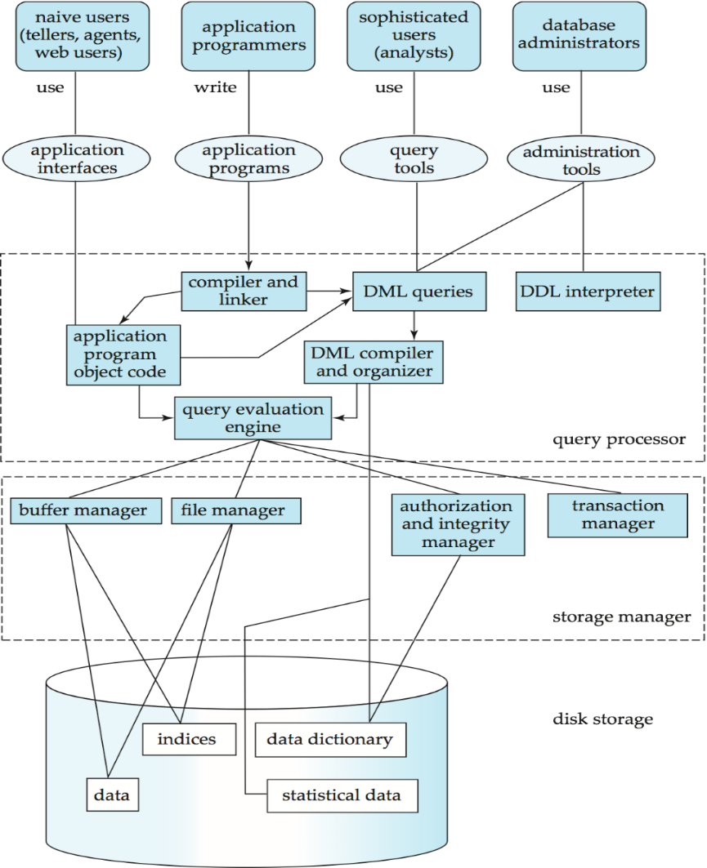
Users
Applications/tools
Database
System
Structure
DBMS
Database

Slide 5
Basic Steps in Query Processing
1. Parsing and translation
2. Optimization
3. Evaluation

Slide 6
Introduction
Alternative ways of evaluating a given query
Equivalent expressions
Different algorithms for each operation
Cost difference between a good and a bad way of evaluating a query can be enormous
Need to estimate the cost of operations
Depends critically on statistical information about relations which the database must maintain
Need to estimate statistics for intermediate results to compute cost of complex expressions

Slide 7
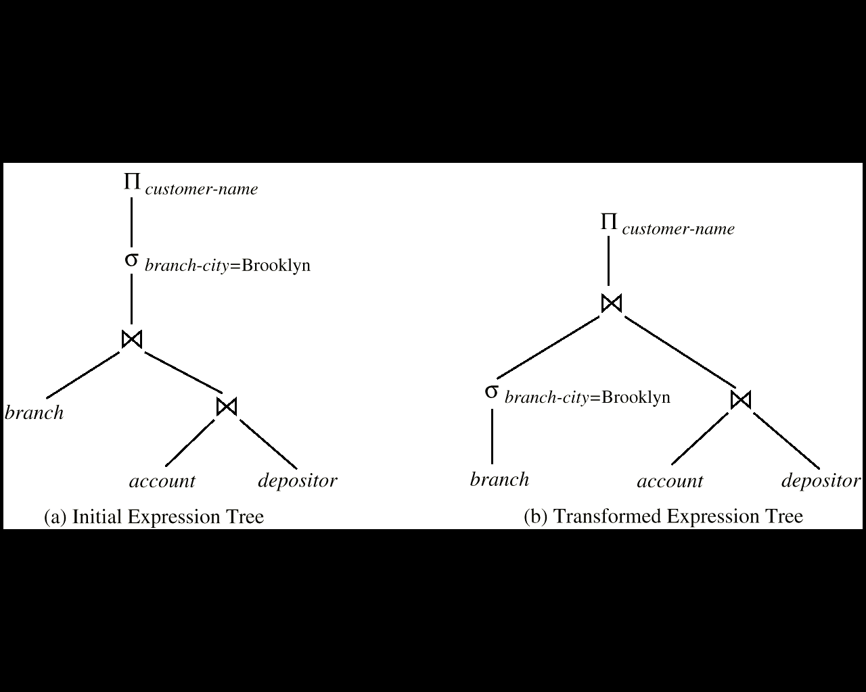
Introduction (Cont.)
Relations generated by two equivalent expressions have the same set of attributes and contain the same set of tuples, although their attributes may be ordered differently.

Slide 8
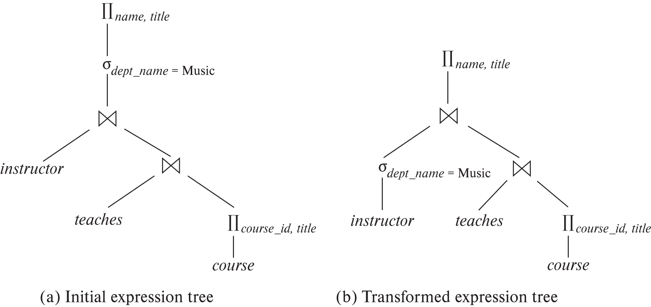
Introduction (Cont.)
Eg：查询找出Music系所有教师的名字以及每位教师所教授课程的名称

Slide 9
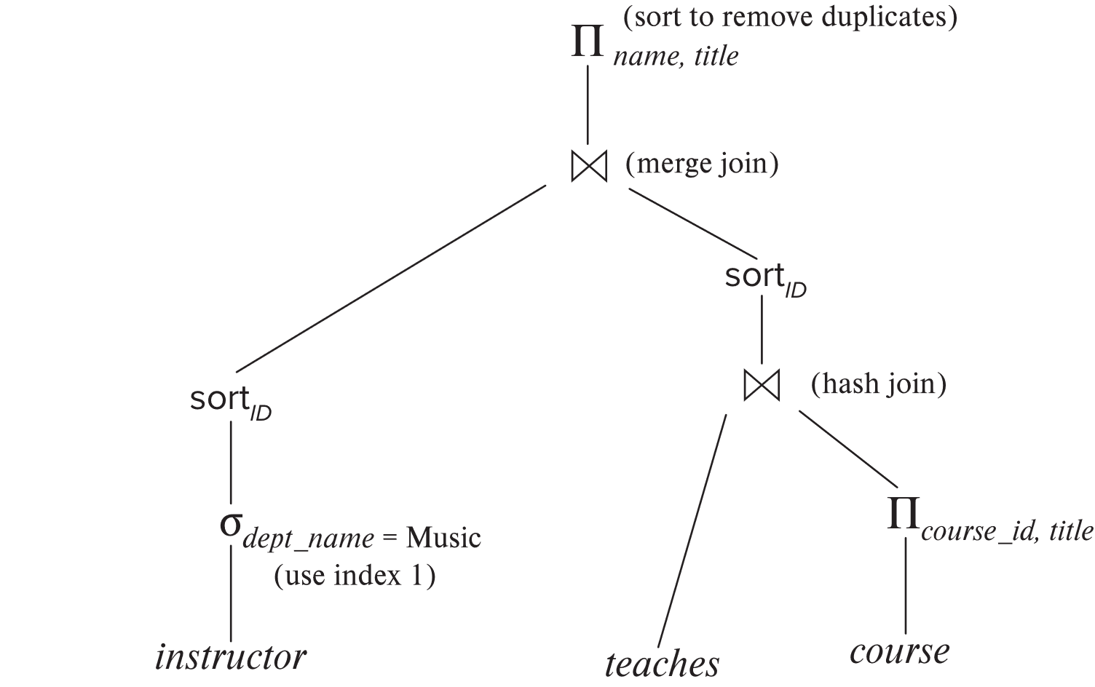
Introduction (Cont.)
执行计划：需明确每个运算应使用的算法以及运算之间的执行如何协调

Slide 10
Introduction (Cont.)
Generation of query-evaluation plans for an expression involves several steps:
Generating logically equivalent expressions(步骤1：产生逻辑上与给定表达式等价的表达式). Use equivalence rules to transform an expression into an equivalent one.
Annotating resultant expressions to get alternative query plans(步骤2：对所产生的表达式以不同方式标注，产生不同的查询执行计划)
Choosing the cheapest plan based on estimated cost(步骤3：估计每个执行计划的代价，选择估计代价最小的执行计划)
The overall process is called cost based optimization

Slide 11
Outline
Introduction
☞ Transformation of Relational Expressions
Catalog Information for Cost Estimation
Estimation of Statistics
Dynamic Programming for Choosing Evaluation Plans

Slide 12
关系表达式转换
Two relational algebra expressions are said to be equivalent if on every legal database instance the two expressions generate the same set of tuples
Note: order of tuples is irrelevant
In SQL, inputs and outputs are multisets of tuples
An equivalence rule says that expressions of two forms are equivalent
Can replace expression of first form by second, or vice versa

Slide 13
Equivalence Rules
Conjunctive selection operations can be deconstructed into a sequence of individual selections.(规则1：合取选择运算可分解为单个选择运算的序列)
Selection operations are commutative.(规则2：选择运算满足交换律)

Slide 14
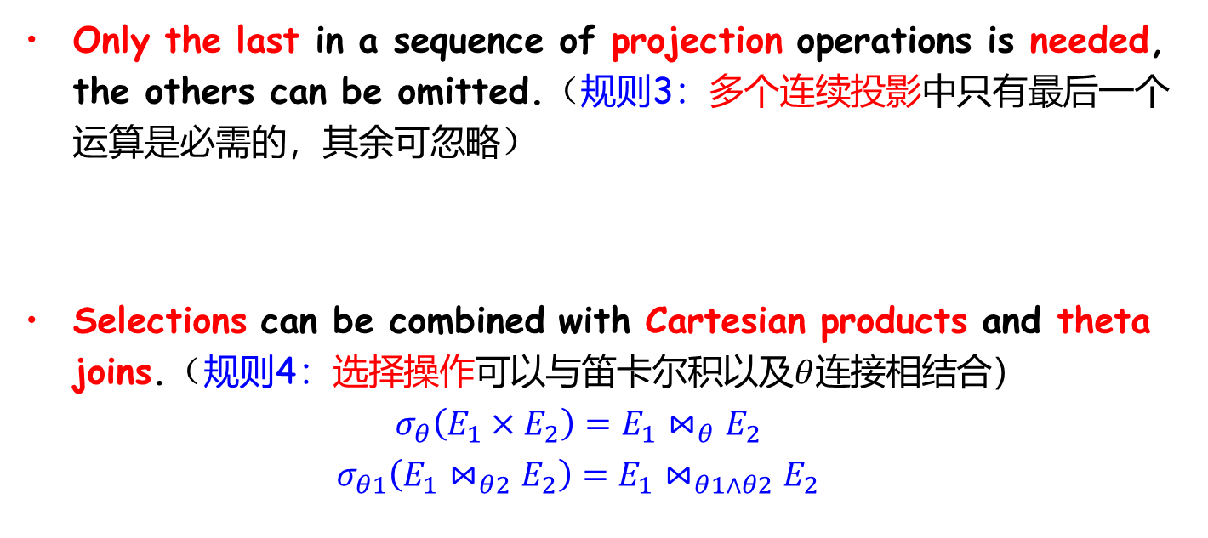
Equivalence Rules
Only the last in a sequence of projection operations is needed, the others can be omitted.（规则3：多个连续投影中只有最后一个运算是必需的，其余可忽略）
Selections can be combined with Cartesian products and theta joins.（规则4：选择操作可以与笛卡尔积以及$θ$连接相结合）
$$σ_{θ}\left(E_{1}×E_{2}\right)=E_{1}⋈_{θ}E_{2}$$
$$σ_{θ1}\left(E_{1}⋈_{θ2}E_{2}\right)=E_{1}⋈_{θ1∧θ2}E_{2}$$

Slide 15
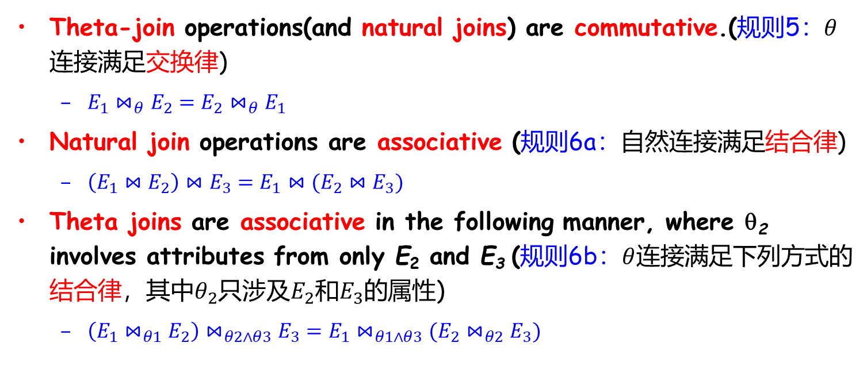
Equivalence Rules (Cont.)
Theta-join operations(and natural joins) are commutative.(规则5：$θ$连接满足交换律)
$E_{1}⋈_{θ}E_{2}=E_{2}⋈_{θ}E_{1}$
Natural join operations are associative (规则6a：自然连接满足结合律)
$\left(E_{1}⋈E_{2}\right)⋈E_{3}=E_{1}⋈(E_{2}⋈E_{3})$
Theta joins are associative in the following manner, where θ₂ involves attributes from only E₂ and E₃ (规则6b：$θ$连接满足下列方式的结合律，其中$θ_{2}$只涉及$E_{2}$和$E_{3}$的属性)
$\left(E_{1}⋈_{θ1}E_{2}\right)⋈_{θ2∧θ3}E_{3}=E_{1}⋈_{θ1∧θ3}(E_{2}⋈_{θ2}E_{3})$

Slide 16
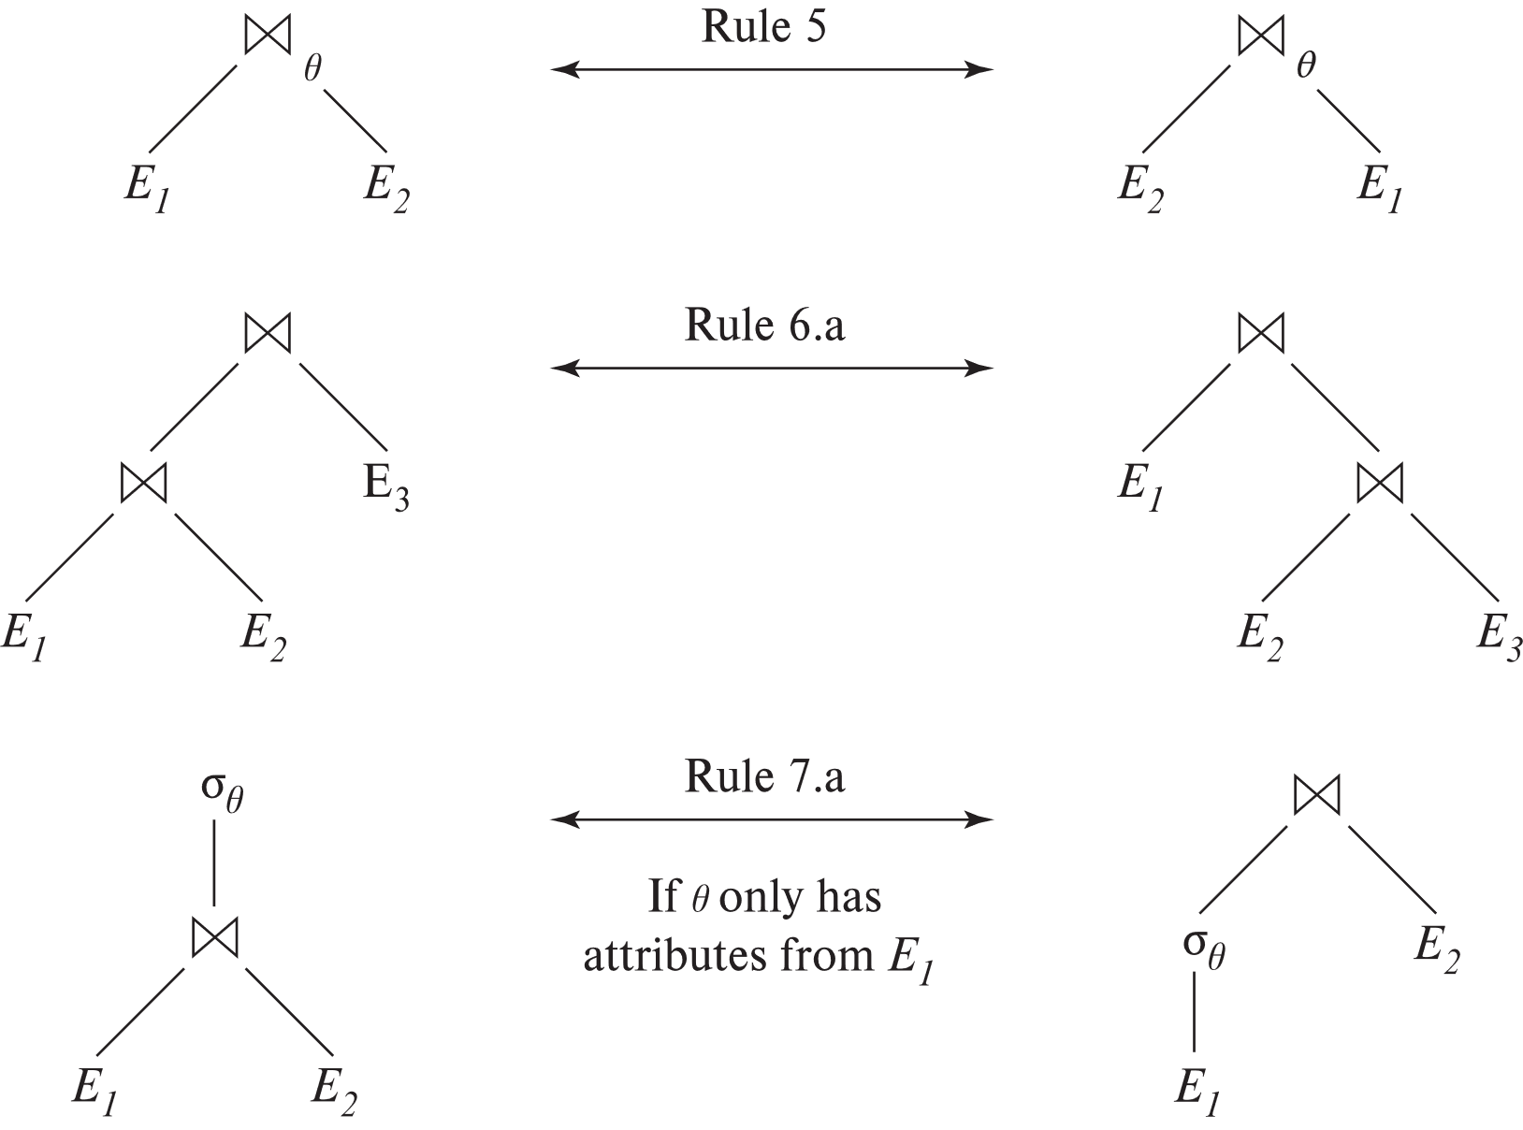

Equivalence Rules (Cont.)
规则5：$θ$连接满足交换律 $E_{1}⋈_{θ}E_{2}=E_{2}⋈_{θ}E_{1}$
规则6a：自然连接满足结合律 $\left(E_{1}⋈E_{2}\right)⋈E_{3}=E_{1}⋈(E_{2}⋈E_{3})$
规则6b：$θ$连接满足下列方式的结合：$\left(E_{1}⋈_{θ1}E_{2}\right)⋈_{θ2∧θ3}E_{3}=E_{1}⋈_{θ1∧θ3}(E_{2}⋈_{θ2}E_{3})$，其中$θ_{2}$只涉及$E_{2}$和$E_{3}$的属性

Slide 17
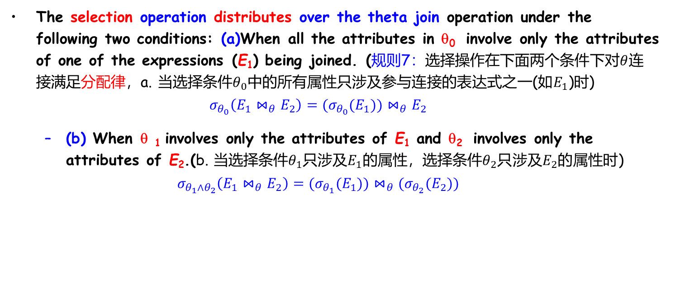
Equivalence Rules (Cont.)
The selection operation distributes over the theta join operation under the following two conditions: (a)When all the attributes in θ₀ involve only the attributes of one of the expressions (E₁) being joined. (规则7：选择操作在下面两个条件下对$θ$连接满足分配律，a. 当选择条件$θ_{0}$中的所有属性只涉及参与连接的表达式之一(如$E_{1}$)时)
$$σ_{θ_{0}}\left(E_{1}⋈_{θ}E_{2}\right)=(σ_{θ_{0}}(E_{1}))⋈_{θ}E_{2}$$
(b) When θ ₁ involves only the attributes of E₁ and θ₂ involves only the attributes of E₂.(b. 当选择条件$θ_{1}$只涉及$E_{1}$的属性，选择条件$θ_{2}$只涉及$E_{2}$的属性时)
$$σ_{θ_{1}∧θ_{2}}\left(E_{1}⋈_{θ}E_{2}\right)=(σ_{θ_{1}}(E_{1}))⋈_{θ}(σ_{θ_{2}}{(E}_{2}))$$

Slide 18
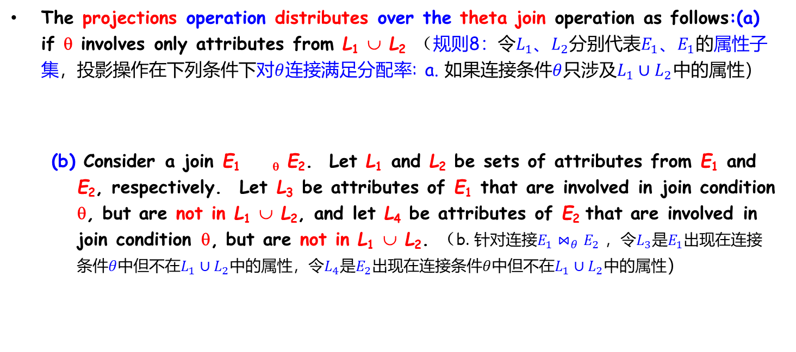
Equivalence Rules (Cont.)
The projections operation distributes over the theta join operation as follows:(a) if θ involves only attributes from L₁ ∪ L₂ （规则8：令$L_{1}$、$L_{2}$分别代表$E_{1}$、$E_{1}$的属性子集，投影操作在下列条件下对$θ$连接满足分配率: a. 如果连接条件$θ$只涉及$L_{1}∪L_{2}$中的属性）
(b) Consider a join E_{1 θ} E₂. Let L₁ and L₂ be sets of attributes from E₁ and E₂, respectively. Let L₃ be attributes of E₁ that are involved in join condition θ, but are not in L₁ ∪ L₂, and let L₄ be attributes of E₂ that are involved in join condition θ, but are not in L₁ ∪ L₂. （b. 针对连接$E_{1}⋈_{θ}E_{2}$ ，令$L_{3}$是$E_{1}$出现在连接条件$θ$中但不在$L_{1}∪L_{2}$中的属性，令$L_{4}$是$E_{2}$出现在连接条件$θ$中但不在$L_{1}∪L_{2}$中的属性）

Slide 19
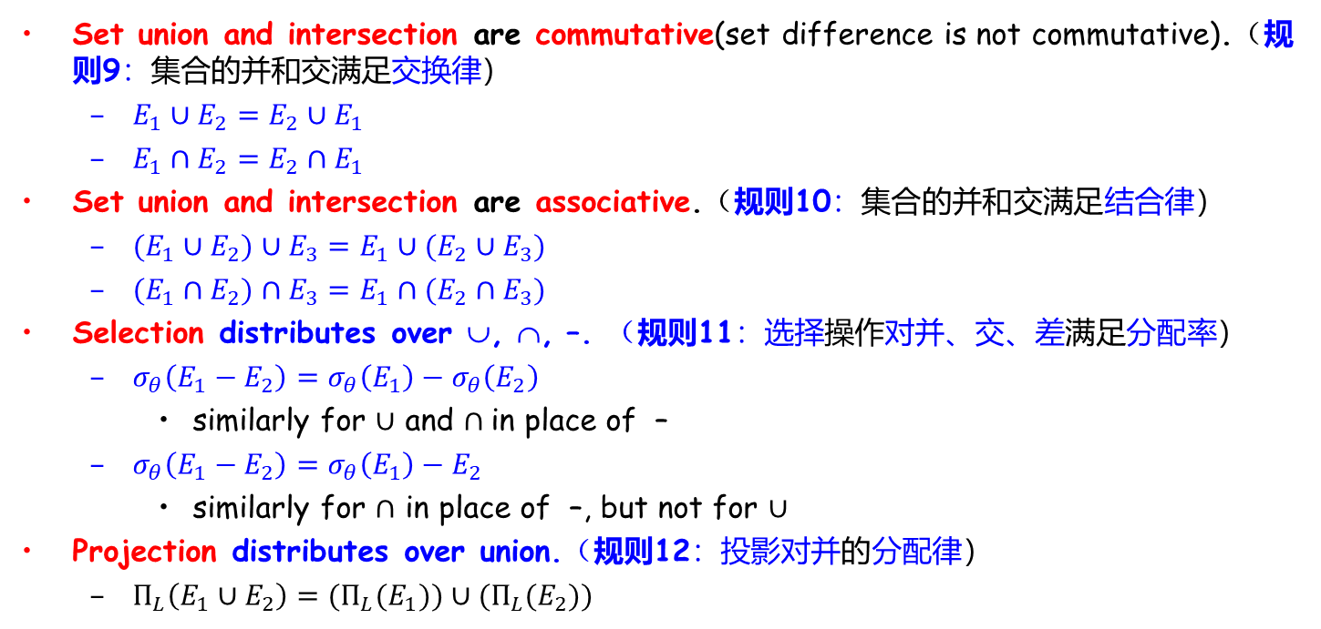
Equivalence Rules (Cont.)
Set union and intersection are commutative(set difference is not commutative).（规则9：集合的并和交满足交换律）
$E_{1}∪E_{2}=E_{2}∪E_{1}$
$E_{1}∩E_{2}=E_{2}∩E_{1}$
Set union and intersection are associative.（规则10：集合的并和交满足结合律）
$(E_{1}∪E_{2})∪E_{3}=E_{1}∪(E_{2}∪E_{3})$
$(E_{1}∩E_{2})∩E_{3}=E_{1}∩(E_{2}∩E_{3})$
Selection distributes over ∪, ∩, –. （规则11：选择操作对并、交、差满足分配率）
$σ_{θ}\left(E_{1}−E_{2}\right)=σ_{θ}\left(E_{1}\right)−σ_{θ}\left(E_{2}\right)$
similarly for $∪$ and $∩$in place of –
$σ_{θ}\left(E_{1}−E_{2}\right)=σ_{θ}\left(E_{1}\right)−E_{2}$
similarly for $∩$ in place of –, but not for $∪$
Projection distributes over union.（规则12：投影对并的分配律）
$Π_{L}\left(E_{1}∪E_{2}\right)=(Π_{L}(E_{1}))∪(Π_{L}(E_{2}))$

Slide 20
Example 1: Pushing Selections
Eg.: Find the names of all instructors in the Music department, along with the titles of the courses that they teach
Π_{name, title}(σ_{dept_name= ‘Music’}(instructor ⨝ (teaches ⨝ Π_{course_id, title} (course))))
Transformation using rule 7a
Π_{name, title}((σ_{dept_name= ‘Music’}(instructor)) ⨝ (teaches ⨝ Π_{course_id, title} (course)))

Slide 21
Example 2: Multiple Transformations
Eg.: Find the names of all instructors in the Music department who have taught a course in 2017, along with the titles of the courses that they taught
Π_{name, title}(σ_{dept_name= "Music”∧year = 2017}(instructor ⨝ (teaches ⨝ Π_{course_id, title} (course))))
Rule 6a:
Π_{name, title}(σ_{dept_name= “Music”∧year = 2017}((instructor ⨝ teaches) ⨝ Π_{course_id, title} (course)))
Rule 7a:
Π_{name, title}((σ_{dept_name= “Music”∧year = 2017}(instructor ⨝ teaches)) ⨝ Π_{course_id, title} (course))
Rule1 & 7a:
Π_{name, title}((σ_{dept_name= “Music”} (instructor) ⨝ σ_{year = 2017} (teaches)) ⨝ Π_{course_id, title} (course))

Slide 22
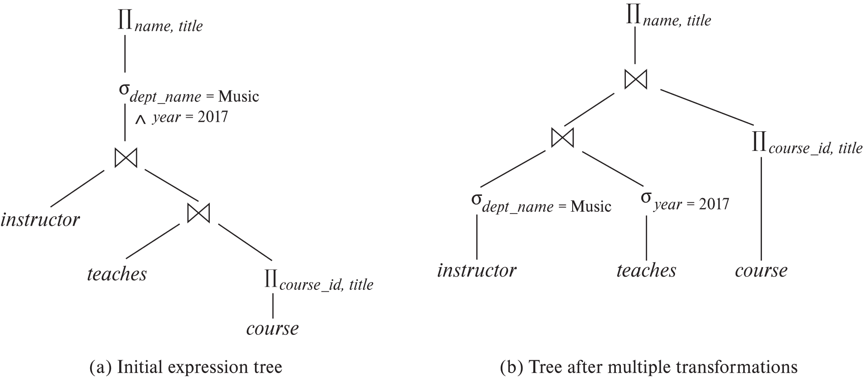
Example 2: Multiple Transformations

Slide 23
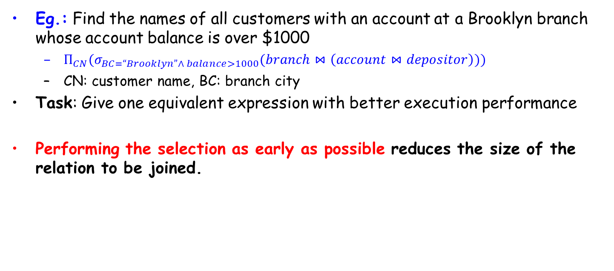
Example 3: Multiple Transformations
Eg.: Find the names of all customers with an account at a Brooklyn branch whose account balance is over $1000
$Π_{CN}(σ_{BC=“Brooklyn”∧ balance>1000}(branch⋈\left(account⋈depositor\right)))$
CN: customer name, BC: branch city
Task: Give one equivalent expression with better execution performance
Performing the selection as early as possible reduces the size of the relation to be joined.

Slide 24
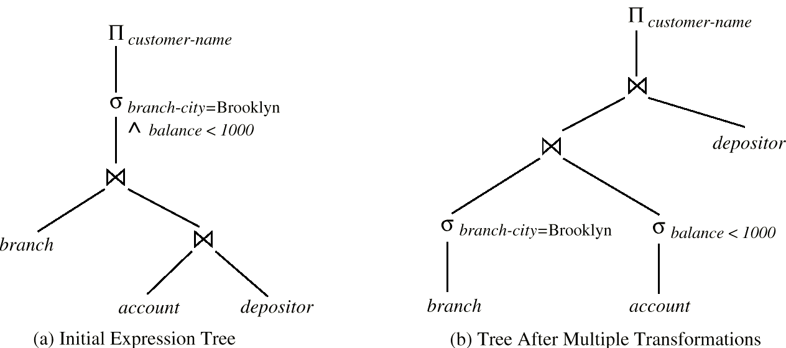
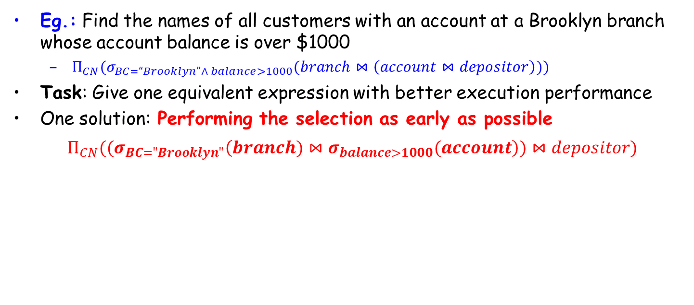
Example 3: Multiple Transformations
Eg.: Find the names of all customers with an account at a Brooklyn branch whose account balance is over $1000
$Π_{CN}(σ_{BC=“Brooklyn”∧ balance>1000}(branch⋈\left(account⋈depositor\right)))$
Task: Give one equivalent expression with better execution performance
One solution: Performing the selection as early as possible
$Π_{CN}((σ_{BC="Brooklyn"}\left(branch)⋈σ_{balance>1000}(account\right))⋈depositor)$

Slide 25
Example 4: Projection Operation
Π_{customer-name}((σ_{branch-city = “Brooklyn”} (branch) account) depositor)
When we compute
(σ_{branch-city = “Brooklyn”} (branch) account ) we obtain a relation whose schema is: (branch-name, branch-city, assets, account-number, balance)
Push projections using equivalence rules 8a and 8b; eliminate unneeded attributes from intermediate results to get: Π _{customer-name} ( Π _{account-number} ((σ_{branch-city = “Brooklyn”} (branch) account) depositor))

Slide 26
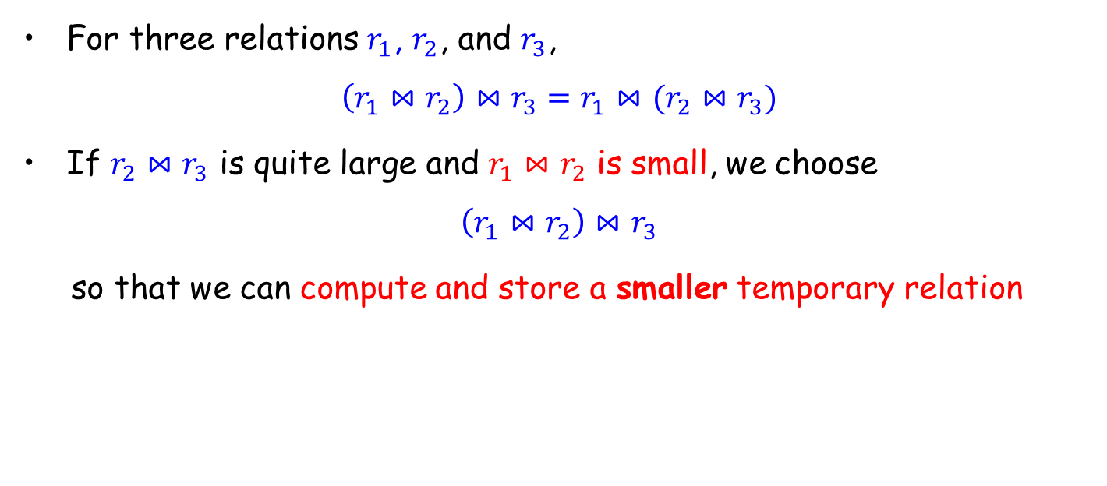
Join Ordering
For three relations $r_{1}$, $r_{2}$, and $r_{3}$,
$$\left(r_{1}⋈r_{2}\right)⋈r_{3}=r_{1}⋈(r_{2}⋈r_{3})$$
If $r_{2}⋈r_{3}$ is quite large and $r_{1}⋈r_{2}$ is small, we choose
$$\left(r_{1}⋈r_{2}\right)⋈r_{3}$$
so that we can compute and store a smaller temporary relation

Slide 27
Join Ordering (Cont.)
Consider the expression
Π_{name, title}(σ_{dept_name= “Music”} (instructor) ⨝ teaches) ⨝ Π_{course_id, title} (course))))
Solution A
compute (teaches ⨝ Π_{course_id, title} (course)) first, and join the result with σ_{dept_name=“Music”}(instructor)
the result of the first join is likely to be a large relation
Solution B
compute (σ_{dept_name=“Music”}(instructor) ⨝ teaches) first
only a small fraction of instructors are likely to be from the Music department

Slide 28
Outline
Introduction
Transformation of Relational Expressions
☞ Catalog Information for Cost Estimation
Estimation of Statistics
Dynamic Programming for Choosing Evaluation Plans

Slide 29
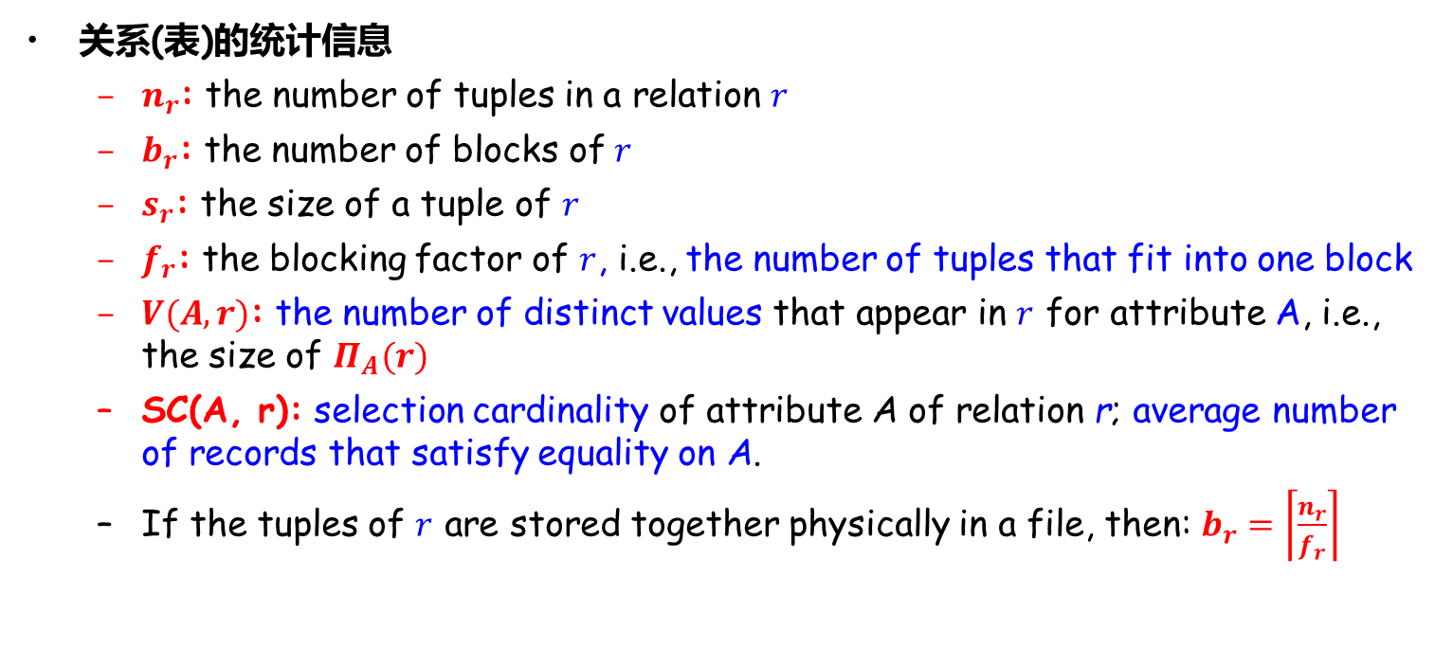
Statistical Information for Relation
关系(表)的统计信息
$n_{r}$: the number of tuples in a relation $r$
$b_{r}$: the number of blocks of $r$
$s_{r}$: the size of a tuple of $r$
$f_{r}$: the blocking factor of $r$, i.e., the number of tuples that fit into one block
$V(A,r)$: the number of distinct values that appear in $r$ for attribute A, i.e., the size of $Π_{A}(r)$
SC(A, r): selection cardinality of attribute A of relation r; average number of records that satisfy equality on A.
If the tuples of $r$ are stored together physically in a file, then: $b_{r}=\left\lceil \frac{n_{r}}{f_{r}}\right\rceil$
Estimation
Size
Distinct Values

Slide 30
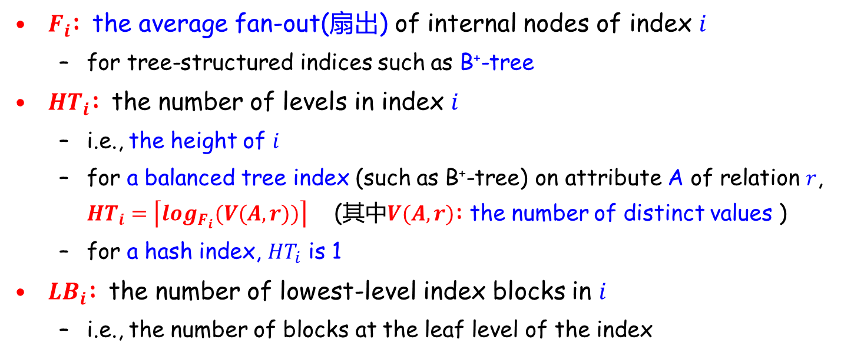
Catalog Information about Indices
$F_{i}$: the average fan-out(扇出) of internal nodes of index $i$
for tree-structured indices such as B⁺-tree
${HT}_{i}$: the number of levels in index $i$
i.e., the height of $i$
for a balanced tree index (such as B⁺-tree) on attribute A of relation $r$, ${HT}_{i}=\left\lceil \log_{F_{i}}(V(A,r))\right\rceil$ (其中$V(A,r)$: the number of distinct values )
for a hash index, ${HT}_{i}$ is 1
${LB}_{i}$: the number of lowest-level index blocks in $i$
i.e., the number of blocks at the leaf level of the index

Slide 31
Measures of Query Cost
Recall that
Typically, disk access is the predominant cost, and is also relatively easy to be estimated
The number of block transfers from disk is used as a measure of the actual cost of evaluation
It is assumed that all transfers of blocks have the same cost
Usually do not include the cost to write output to disk
We refer to the cost estimate of algorithm A as E_{A}

Slide 32
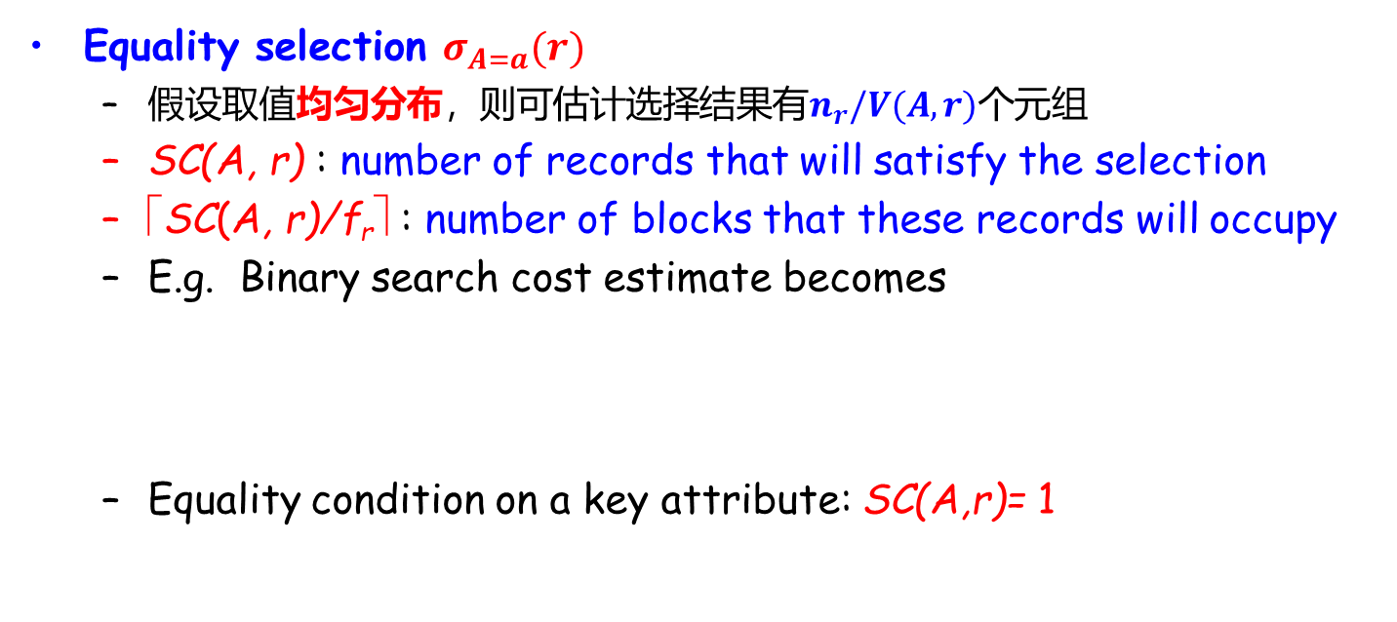
简单选择操作结果大小估计
Equality selection $σ_{A=a}(r)$
假设取值均匀分布，则可估计选择结果有$n_{r}/V(A,r)$个元组
SC(A, r) : number of records that will satisfy the selection
⎡SC(A, r)/f_{r}⎤ : number of blocks that these records will occupy
E.g. Binary search cost estimate becomes
Equality condition on a key attribute: SC(A,r)= 1

Slide 33
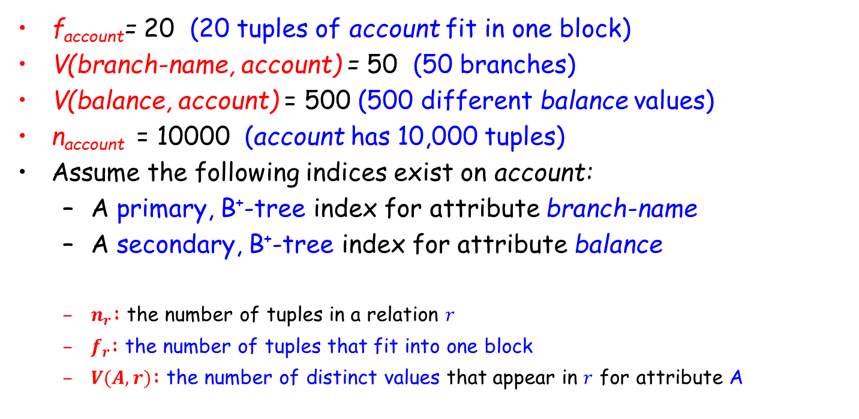
Statistical Information for Examples
f_{account}= 20 (20 tuples of account fit in one block)
V(branch-name, account) = 50 (50 branches)
V(balance, account) = 500 (500 different balance values)
n_{account} = 10000 (account has 10,000 tuples)
Assume the following indices exist on account:
A primary, B⁺-tree index for attribute branch-name
A secondary, B⁺-tree index for attribute balance
$n_{r}$: the number of tuples in a relation $r$
$f_{r}$: the number of tuples that fit into one block
$V(A,r)$: the number of distinct values that appear in $r$ for attribute A

Slide 34
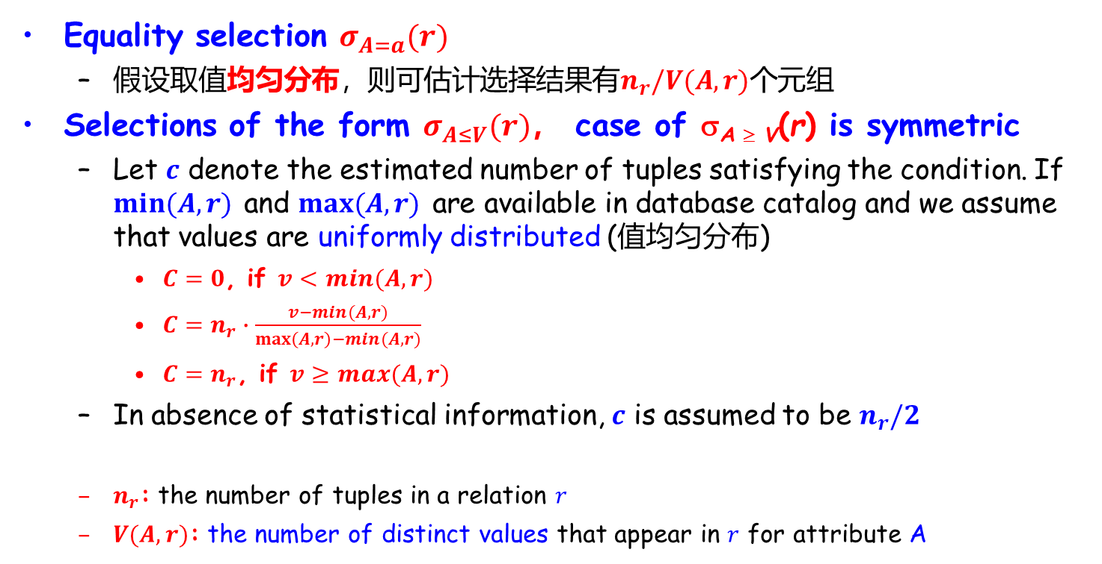
简单选择操作结果大小估计
Equality selection $σ_{A=a}(r)$
假设取值均匀分布，则可估计选择结果有$n_{r}/V(A,r)$个元组
Selections of the form $σ_{A≤V}(r)$， case of σ_{A ≥ V}(r) is symmetric
Let $c$ denote the estimated number of tuples satisfying the condition. If $min⁡(A,r)$ and $max⁡(A,r)$ are available in database catalog and we assume that values are uniformly distributed (值均匀分布)
$C=0$, if $v<min⁡(A,r)$
$C=n_{r}∙\frac{v−min⁡(A,r)}{\max\left(A,r\right)−min⁡(A,r)}$
$C=n_{r}$, if $v≥max⁡(A,r)$
In absence of statistical information, $c$ is assumed to be $n_{r}/2$
$n_{r}$: the number of tuples in a relation $r$
$V(A,r)$: the number of distinct values that appear in $r$ for attribute A

Slide 35
Outline
Introduction
Transformation of Relational Expressions
Catalog Information for Cost Estimation
☞ Estimation of Statistics
Dynamic Programming for Choosing Evaluation Plans

Slide 36
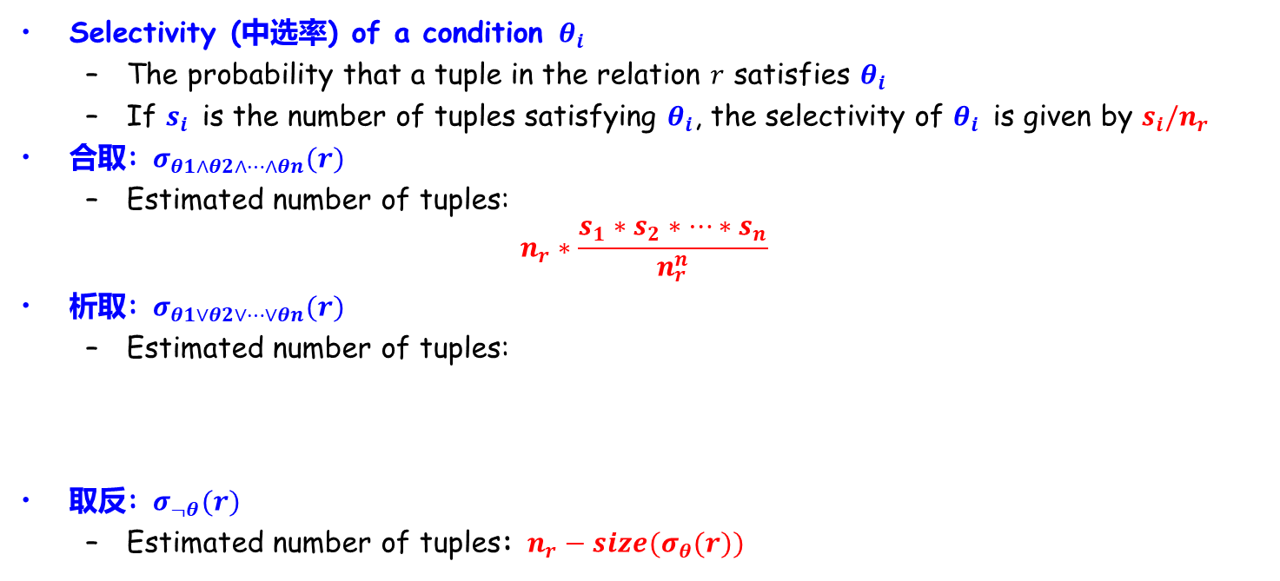
复杂选择操作结果大小估计
Selectivity (中选率) of a condition $θ_{i}$
The probability that a tuple in the relation $r$ satisfies $θ_{i}$
If $s_{i}$ is the number of tuples satisfying $θ_{i}$, the selectivity of $θ_{i}$ is given by $s_{i}/n_{r}$
合取: $σ_{θ1∧θ2∧…∧θn}(r)$
Estimated number of tuples:
$$n_{r}∗\frac{s_{1}∗s_{2}∗…∗s_{n}}{n_{r}^{n}}$$
析取: $σ_{θ1∨θ2∨…∨θn}(r)$
Estimated number of tuples:
取反: $σ_{¬θ}(r)$
Estimated number of tuples: $n_{r}−size(σ_{θ}(r))$

Slide 37
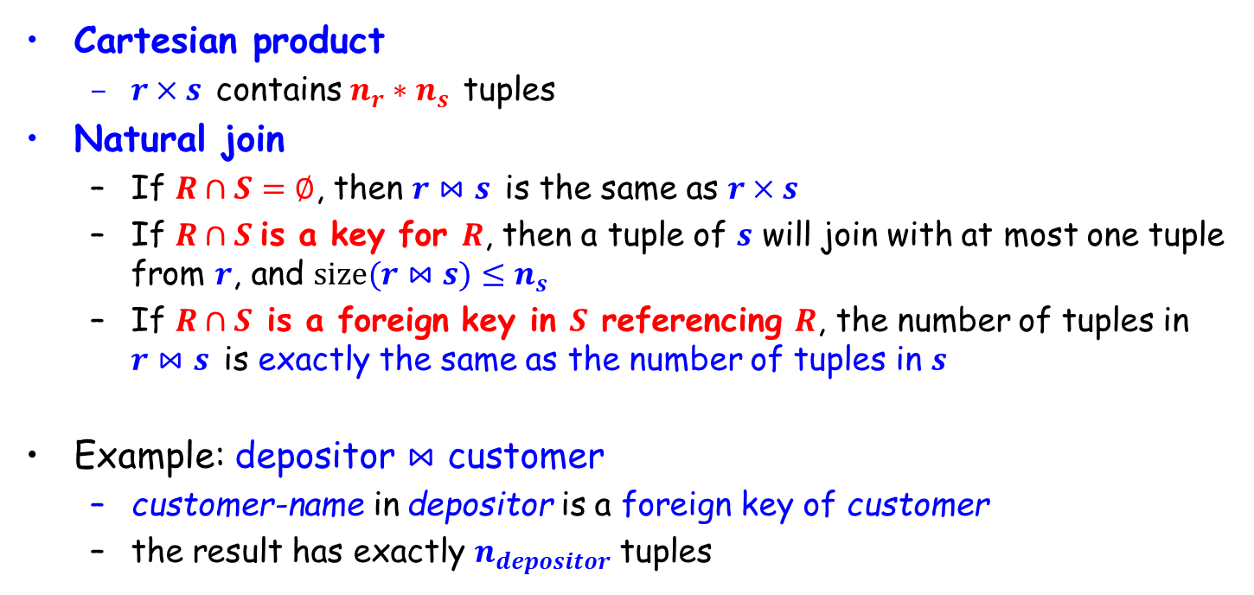
连接操作结果大小估计
Cartesian product
$r×s$ contains $n_{r}∗n_{s}$ tuples
Natural join
If $R∩S=∅$, then $r⋈s$ is the same as $r×s$
If $R∩S$is a key for $R$, then a tuple of $s$ will join with at most one tuple from $r$, and $size(r⋈s)≤n_{s}$
If $R∩S$ is a foreign key in $S$ referencing $R$, the number of tuples in $r⋈s$ is exactly the same as the number of tuples in $s$
Example: depositor $⋈$ customer
customer-name in depositor is a foreign key of customer
the result has exactly $n_{depositor}$ tuples

Slide 38
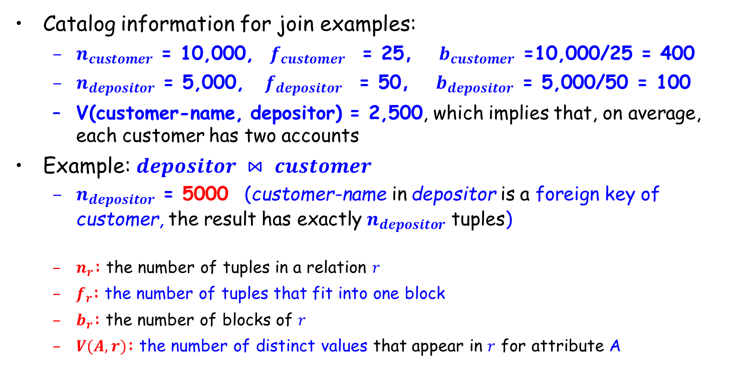
连接操作结果大小估计(续)
Catalog information for join examples:
$n_{customer}$ = 10,000, $f_{customer}$ = 25， $b_{customer}$ =10,000/25 = 400
$n_{depositor}$ = 5,000, ${ f}_{depositor}$ = 50， $b_{depositor}$ = 5,000/50 = 100
V(customer-name, depositor) = 2,500, which implies that, on average, each customer has two accounts
Example: $depositor ⋈ customer$
$n_{depositor}$ = 5000 (customer-name in depositor is a foreign key of customer, the result has exactly $n_{depositor}$ tuples)
$n_{r}$: the number of tuples in a relation $r$
$f_{r}$: the number of tuples that fit into one block
$b_{r}$: the number of blocks of $r$
$V(A,r)$: the number of distinct values that appear in $r$ for attribute A
Notes:
$n_{r}$: the number of tuples in a relation $r$
$b_{r}$: the number of blocks of $r$
$s_{r}$: the size of a tuple of $r$
$f_{r}$: the blocking factor of $r$, i.e., the number of tuples that fit into one block
$V(A,r)$: the number of distinct values that appear in $r$ for attribute A, i.e., the size of $Π_{A}(r)$
SC(A, r): selection cardinality of attribute A of relation r; average number of records that satisfy equality on A.
If the tuples of $r$ are stored together physically in a file, then: $b_{r}=\left\lceil \frac{n_{r}}{f_{r}}\right\rceil$

Slide 39
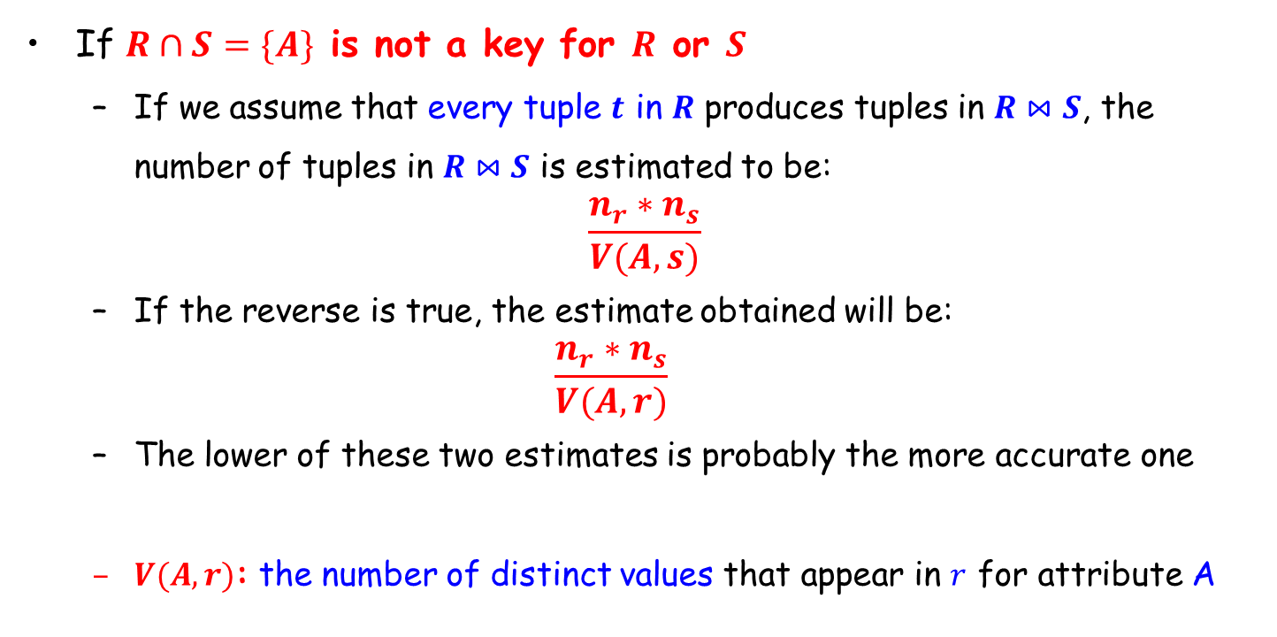
连接操作结果大小估计(续)
If $R∩S=\{A\}$ is not a key for $R$ or $S$
If we assume that every tuple $t$ in $R$ produces tuples in $R⋈S$, the number of tuples in $R⋈S$ is estimated to be:
$$\frac{n_{r}∗n_{s}}{V(A,s)}$$
If the reverse is true, the estimate obtained will be:
$$\frac{n_{r}∗n_{s}}{V(A,r)}$$
The lower of these two estimates is probably the more accurate one
$V(A,r)$: the number of distinct values that appear in $r$ for attribute A

Slide 40
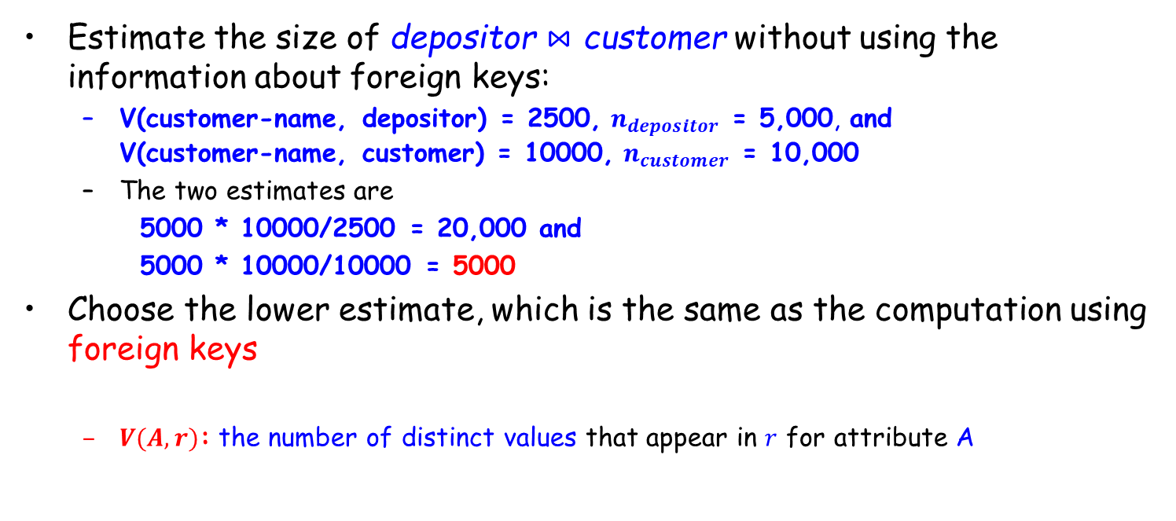
连接操作结果大小估计(续)
Estimate the size of depositor $⋈$ customer without using the information about foreign keys:
V(customer-name, depositor) = 2500, $n_{depositor}$ = 5,000, and V(customer-name, customer) = 10000, $n_{customer}$ = 10,000
The two estimates are
5000 * 10000/2500 = 20,000 and
5000 * 10000/10000 = 5000
Choose the lower estimate, which is the same as the computation using foreign keys
$V(A,r)$: the number of distinct values that appear in $r$ for attribute A

Slide 41
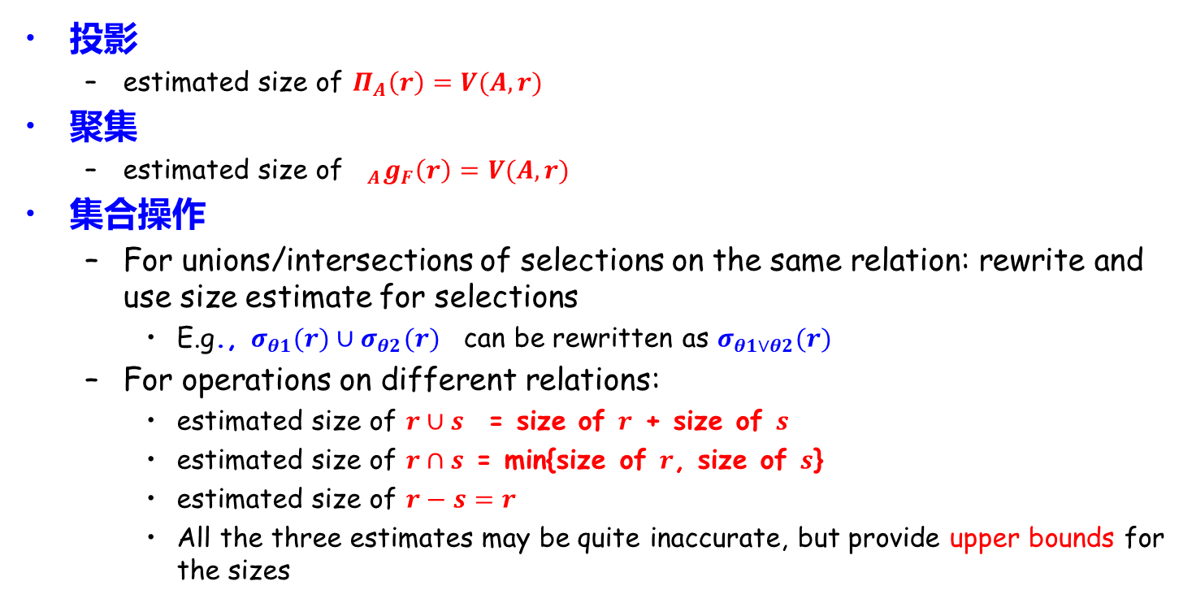
其他操作结果集大小估计
投影
estimated size of $Π_{A}\left(r\right)=V(A,r)$
聚集
estimated size of${{}_{A}g}_{F}\left(r\right)=V(A,r)$
集合操作
For unions/intersections of selections on the same relation: rewrite and use size estimate for selections
E.g., $σ_{θ1}(r)∪σ_{θ2}(r)$ can be rewritten as $σ_{θ1∨θ2}(r)$
For operations on different relations:
estimated size of $r∪s$ = size of $r$ + size of $s$
estimated size of $r∩s$ = min{size of $r$, size of $s$}
estimated size of $r−s=r$
All the three estimates may be quite inaccurate, but provide upper bounds for the sizes

Slide 42

其他操作结果集大小估计（续）
Outer join
Estimated size of $r s$ = size of $r⋈s$ + size of $r$
Case of right outer join is symmetric
Estimated size of $r s$ = size of $r⋈s$ + size of $r$ + size of $s$

Slide 43
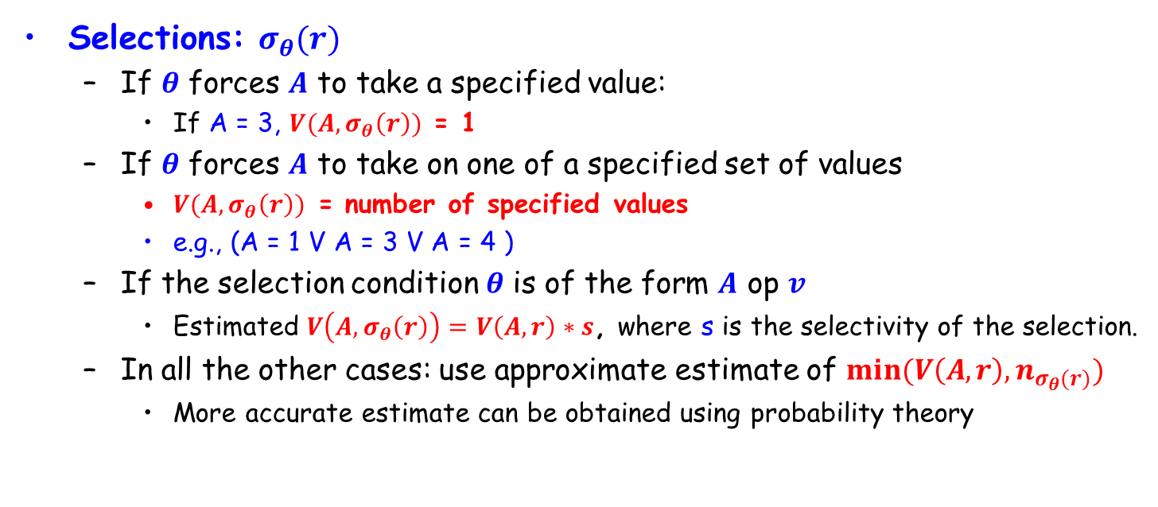
Estimation of Distinct Values
Selections: $σ_{θ}(r)$
If $θ$ forces $A$ to take a specified value:
If A = 3, $V(A,σ_{θ}\left(r\right))$ = 1
If $θ$ forces $A$ to take on one of a specified set of values
$V(A,σ_{θ}\left(r\right))$ = number of specified values
e.g., (A = 1 V A = 3 V A = 4 )
If the selection condition $θ$ is of the form $A$ op $v$
Estimated $V\left(A,σ_{θ}\left(r\right)\right)=V\left(A,r\right)∗s$, where s is the selectivity of the selection.
In all the other cases: use approximate estimate of $min⁡(V\left(A,r\right),n_{σ_{θ}(r)})$
More accurate estimate can be obtained using probability theory

Slide 44
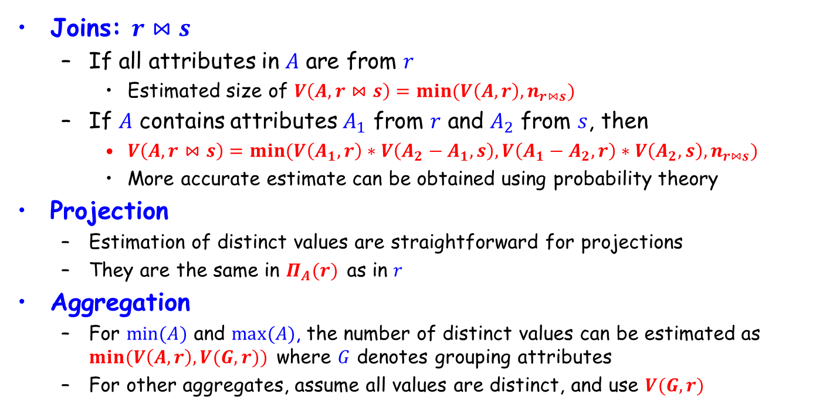
Estimation of Distinct Values (Cont.)
Joins: $r⋈s$
If all attributes in $A$ are from $r$
Estimated size of $V\left(A,r⋈s\right)=min⁡(V\left(A,r\right),n_{r⋈s})$
If $A$ contains attributes $A_{1}$ from $r$ and $A_{2}$ from $s$, then
$V\left(A,r⋈s\right)=min⁡(V\left(A_{1},r\right)∗V\left(A_{2}−A_{1},s\right),V\left(A_{1}−A_{2},r\right)∗V\left(A_{2},s\right),n_{r⋈s})$
More accurate estimate can be obtained using probability theory
Projection
Estimation of distinct values are straightforward for projections
They are the same in $Π_{A}(r)$ as in $r$
Aggregation
For $min⁡(A)$ and $max⁡(A)$, the number of distinct values can be estimated as $min⁡(V\left(A,r\right),V(G,r))$ where $G$ denotes grouping attributes
For other aggregates, assume all values are distinct, and use $V(G,r)$

Slide 45
Outline
Introduction
Transformation of Relational Expressions
Catalog Information for Cost Estimation
Estimation of Statistics
☞ Dynamic Programming for Choosing Evaluation Plans

Slide 46
Enumeration of Equivalent Expressions
Query optimizers use equivalence rules to systematically generate expressions equivalent to the given expression
Conceptually, generate all equivalent expressions by repeatedly executing the following step until no more expressions can be found
Given an expression E, if any sub-expression Es of E matches one side of an equivalence rule, the optimizer generates a new expression where Es is transformed to match the other side of the rule
The above approach is very expensive in space and time.
Space requirements reduced by sharing common sub-expressions for equivalent expressions
Time requirements are reduced by not generating all expressions

Slide 47
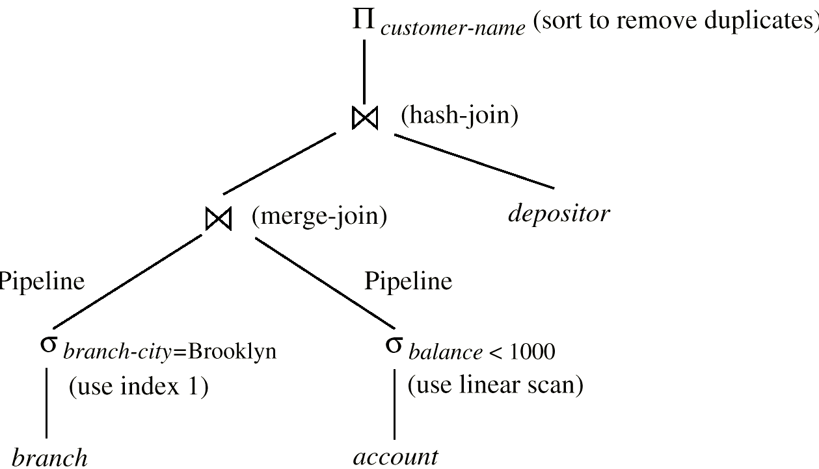
Evaluation Plan
An evaluation plan defines exactly what algorithm is used for each operation, and how the execution of the operations is coordinated

Slide 48
Choice of Evaluation Plans
Must consider the interaction of evaluation techniques when choosing evaluation plans.
choosing the cheapest algorithm for each operation independently may not yield best overall algorithm.
merge-join may be costlier than hash-join, but may provide a sorted output which reduces the cost for an outer level aggregation
nested-loop join may provide opportunity for pipelining
Practical query optimizers incorporate elements of the following two broad approaches:
1. Search all the plans and choose the best plan in a cost-based fashion
2. Uses heuristics to choose a plan

Slide 49
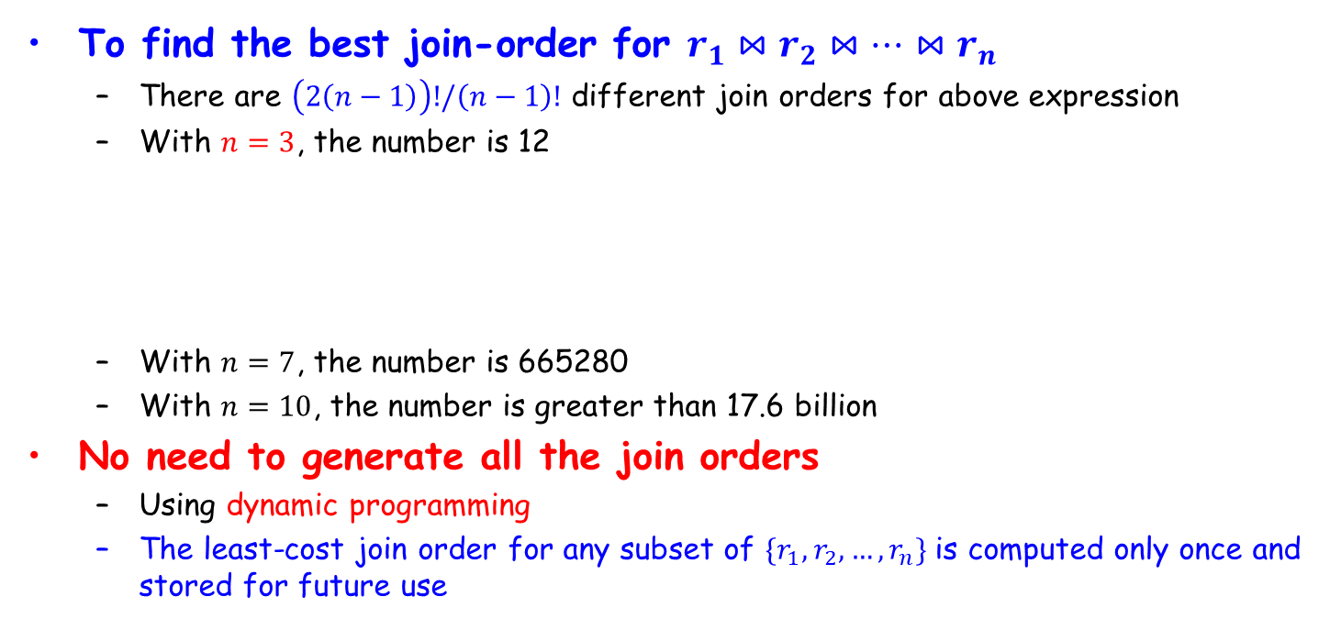
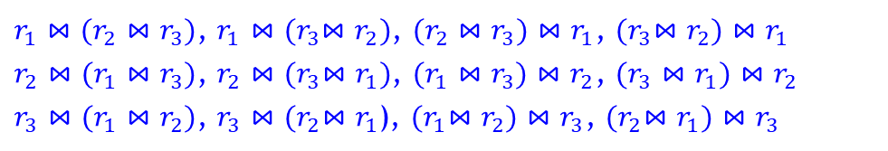
Cost-based Optimization
To find the best join-order for $r_{1}⋈r_{2}⋈…{⋈r}_{n}$
There are $\left(2\left(n−1\right)\right)!/\left(n−1\right)!$ different join orders for above expression
With $n=3$, the number is 12
With $n=7$, the number is 665280
With $n=10$, the number is greater than 17.6 billion
No need to generate all the join orders
Using dynamic programming
The least-cost join order for any subset of $\{r_{1},r_{2},…,r_{n}\}$ is computed only once and stored for future use
$r_{1}⋈(r_{2}⋈r_{3})$, $r_{1}⋈{(r}_{3}⋈r_{2})$, $(r_{2}⋈r_{3})⋈r_{1}$, ${(r}_{3}⋈r_{2})⋈r_{1}$
$r_{2}⋈(r_{1}⋈r_{3})$, $r_{2}⋈{(r}_{3}⋈r_{1})$, $(r_{1}⋈r_{3})⋈r_{2}$, $(r_{3}⋈r_{1})⋈r_{2}$
$r_{3}⋈(r_{1}⋈r_{2})$, $r_{3}⋈{(r}_{2}⋈r_{1}$), ${(r}_{1}⋈r_{2})⋈r_{3}$, ${(r}_{2}⋈r_{1})⋈r_{3}$

Slide 50
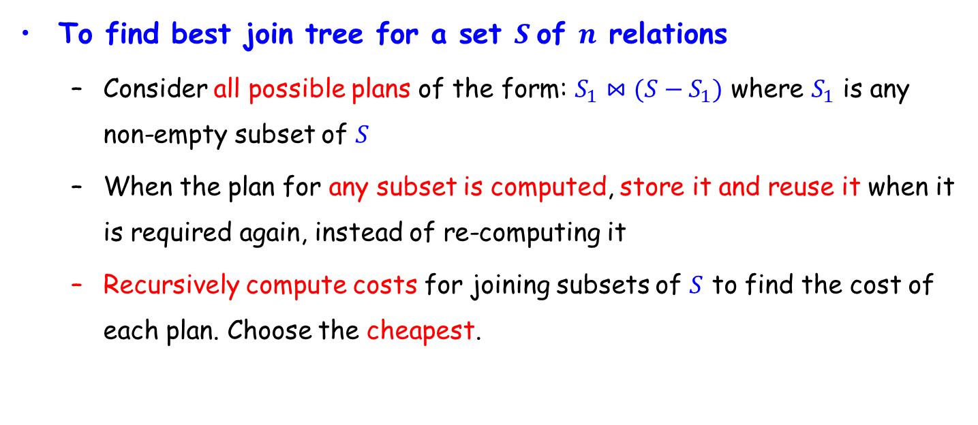
Dynamic Programming in Optimization
To find best join tree for a set $S$of $n$ relations
Consider all possible plans of the form: $S_{1}⋈(S−S_{1})$ where $S_{1}$ is any non-empty subset of $S$
When the plan for any subset is computed, store it and reuse it when it is required again, instead of re-computing it
Recursively compute costs for joining subsets of $S$ to find the cost of each plan. Choose the cheapest.

Slide 51
Join Order Optimization Algorithm
procedure findbestplan(S) if (bestplan[S].cost ≠ ∞) return bestplan[S] if (S contains only 1 relation)
set bestplan[S].plan and bestplan[S].cost based on best way of accessing S else for each non-empty subset S1 of S such that S1 ≠ S P1= findbestplan(S1) P2= findbestplan(S - S1) A = best algorithm for joining results of P1 and P2 cost = P1.cost + P2.cost + cost of A if cost < bestplan[S].cost bestplan[S].cost = cost bestplan[S].plan = “execute P1.plan;
execute P2.plan;
join results of P1 and P2 using A” return bestplan[S]
Dynamic-programming algorithm

Slide 52
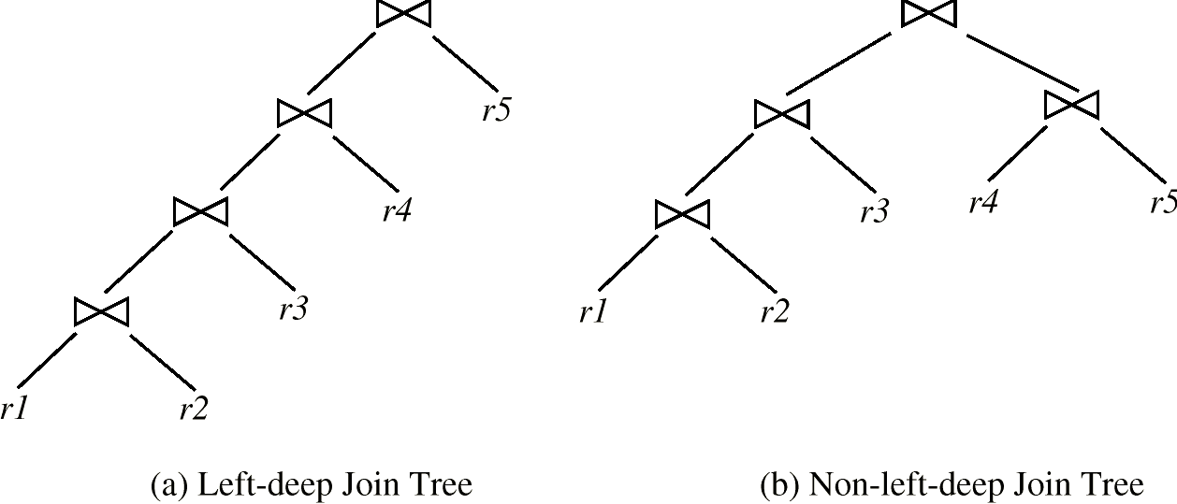
Left Deep Join Trees
In left-deep join trees, the right-hand-side input for each join is a relation, not the result of an intermediate join

Slide 53
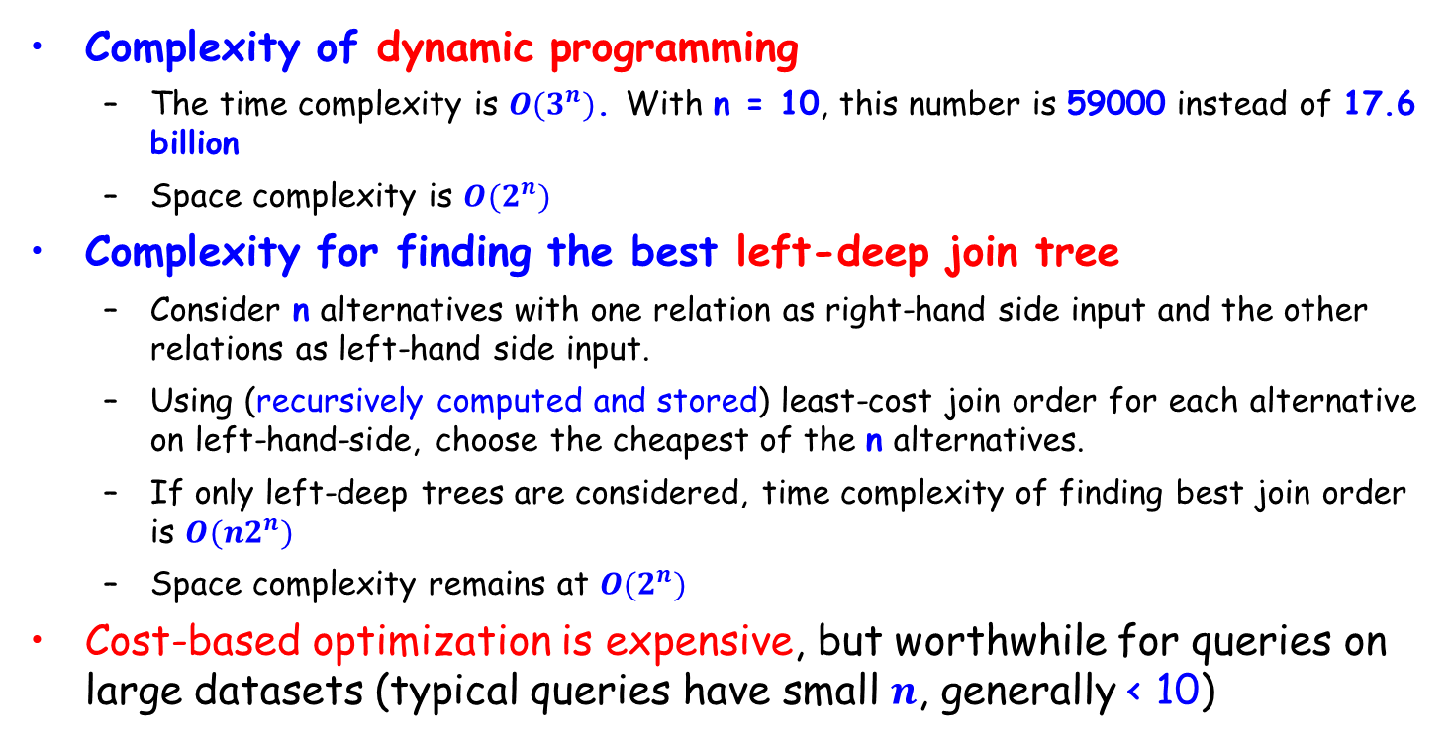
Cost of Optimization
Complexity of dynamic programming
The time complexity is $O(3^{n})$. With n = 10, this number is 59000 instead of 17.6 billion
Space complexity is $O(2^{n})$
Complexity for finding the best left-deep join tree
Consider n alternatives with one relation as right-hand side input and the other relations as left-hand side input.
Using (recursively computed and stored) least-cost join order for each alternative on left-hand-side, choose the cheapest of the n alternatives.
If only left-deep trees are considered, time complexity of finding best join order is $O(n2^{n})$
Space complexity remains at $O(2^{n})$
Cost-based optimization is expensive, but worthwhile for queries on large datasets (typical queries have small $n$, generally < 10)

Slide 54
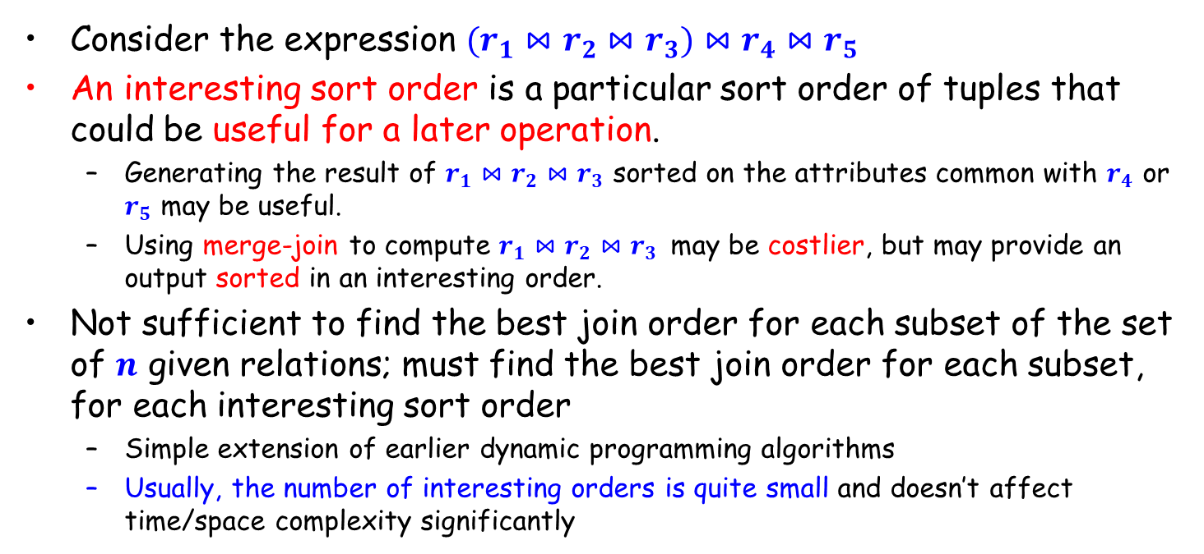
Interesting Orders in Cost-based Optimization
Consider the expression $(r_{1}⋈r_{2}⋈r_{3})⋈r_{4}⋈r_{5}$
An interesting sort order is a particular sort order of tuples that could be useful for a later operation.
Generating the result of $r_{1}⋈r_{2}⋈r_{3}$ sorted on the attributes common with $r_{4}$ or $r_{5}$ may be useful.
Using merge-join to compute $r_{1}⋈r_{2}⋈r_{3}$ may be costlier, but may provide an output sorted in an interesting order.
Not sufficient to find the best join order for each subset of the set of $n$ given relations; must find the best join order for each subset, for each interesting sort order
Simple extension of earlier dynamic programming algorithms
Usually, the number of interesting orders is quite small and doesn’t affect time/space complexity significantly

Slide 55
Heuristic Optimization
Cost-based optimization is expensive, even with dynamic programming.
Systems may use heuristics to reduce the number of choices that must be made in a cost-based fashion.
Heuristic optimization transforms the query-tree by using a set of rules that typically (but not in all cases) improve execution performance:
Perform selection early (reduces the number of tuples)
Perform projection early (reduces the number of attributes)
Perform most restrictive selection and join operations before other similar operations.
Some systems use only heuristics, others combine heuristics with partial cost-based optimization.

Slide 56
Steps in Typical Heuristic Optimization
Deconstruct conjunctive selections into a sequence of single selection operations (Equiv. rule 1.).
2. Move selection operations down the query tree for the earliest possible execution (Equiv. rules 2, 7a, 7b, 11).
3. Execute first those selection and join operations that will produce the smallest relations (Equiv. rule 6).
4. Replace Cartesian product operations that are followed by a selection condition by join operations (Equiv. rule 4a).
5. Deconstruct and move as far down the tree as possible lists of projection attributes, creating new projections where needed (Equiv. rules 3, 8a, 8b, 12).
6. Identify those subtrees whose operations can be pipelined, and execute them using pipelining.

Slide 57
Assignment
16.16 (第7版)
Canvas上提交，单个PDF文件
Deadline：2023年12月13日

Slide 58
End of Lecture 16

